Slide 1
Maintaining Information Systems

Slide 2
Learning Objectives
Explain and contrast four types of maintenance
Describe several factors that influence the cost of maintaining an information system
Describe maintenance management issues including alternative organizational structures, quality measurement, processes for handling change requests and configuration management
Explain the role of CASE when maintaining information systems
18.<number>

Slide 3
The Process of Maintaining Information Systems
Process of returning to the beginning of the SDLC and repeating development steps focusing on system change until the change is implemented
Four major activities
  Obtaining maintenance requests
  Transforming requests into changes
  Designing changes
  Implementing changes
18.<number>

Slide 4
The Process of Maintaining Information Systems
Deliverables and Outcomes
  Development of a new version of the software and new versions of all design documents created or modified during the maintenance effort
18.<number>

Slide 5
Conducting System Maintenance
Corrective maintenance
  Changes made to a system to repair flaws in its design, coding, or implementation
Adaptive maintenance
  Changes made to a system to evolve its functionality to changing business needs or technologies
Perfective maintenance
  Changes made to a system to add new features or to improve performance
Preventive maintenance
  Changes made to a system to avoid possible future problems
18.<number>

Slide 6
Conducting System Maintenance
The Cost of Maintenance
Many organizations allocate eighty percent of information systems budget to maintenance
Factors that influence system maintainability
  Latent defects
  Number of customers for a given system
  Quality of system documentation
  Maintenance personnel
  Tools
  Well-structured programs
18.<number>

Slide 7
Conducting System Maintenance
Managing Maintenance
Number of people working in maintenance has surpassed number working in development
Three possible organizational structures
  Separate
    Maintenance group consists of different personnel than development group
  Combined
    Developers also maintain systems
  Functional
    Maintenance personnel work within the functional business unit
  Table 18-4 presents the advantages and disadvantages to each approach
18.<number>

Slide 8
Conducting System Maintenance
Managing Maintenance
Assignment of personnel
  Maintenance work is often viewed negatively by IS personnel
  Organizations have historically have rewarded people involved in new development better than maintenance personnel
  Organizations often rotate personnel in and out of maintenance roles in order to lessen negative feelings about maintenance
18.<number>

Slide 9
Conducting System Maintenance
Measures of Effectiveness
Number of failures
Time between each failure
Type of failure
Mean time between failures (MTBF)
  A measurement of error occurrences that can be tracked over time to indicate the quality of a system
18.<number>

Slide 10
Controlling Maintenance Requests
Determine type of request
  Error
  Adaptation
  Enhancement
Figure 18-9 shows a flowchart for a request procedure
18.<number>

Slide 11
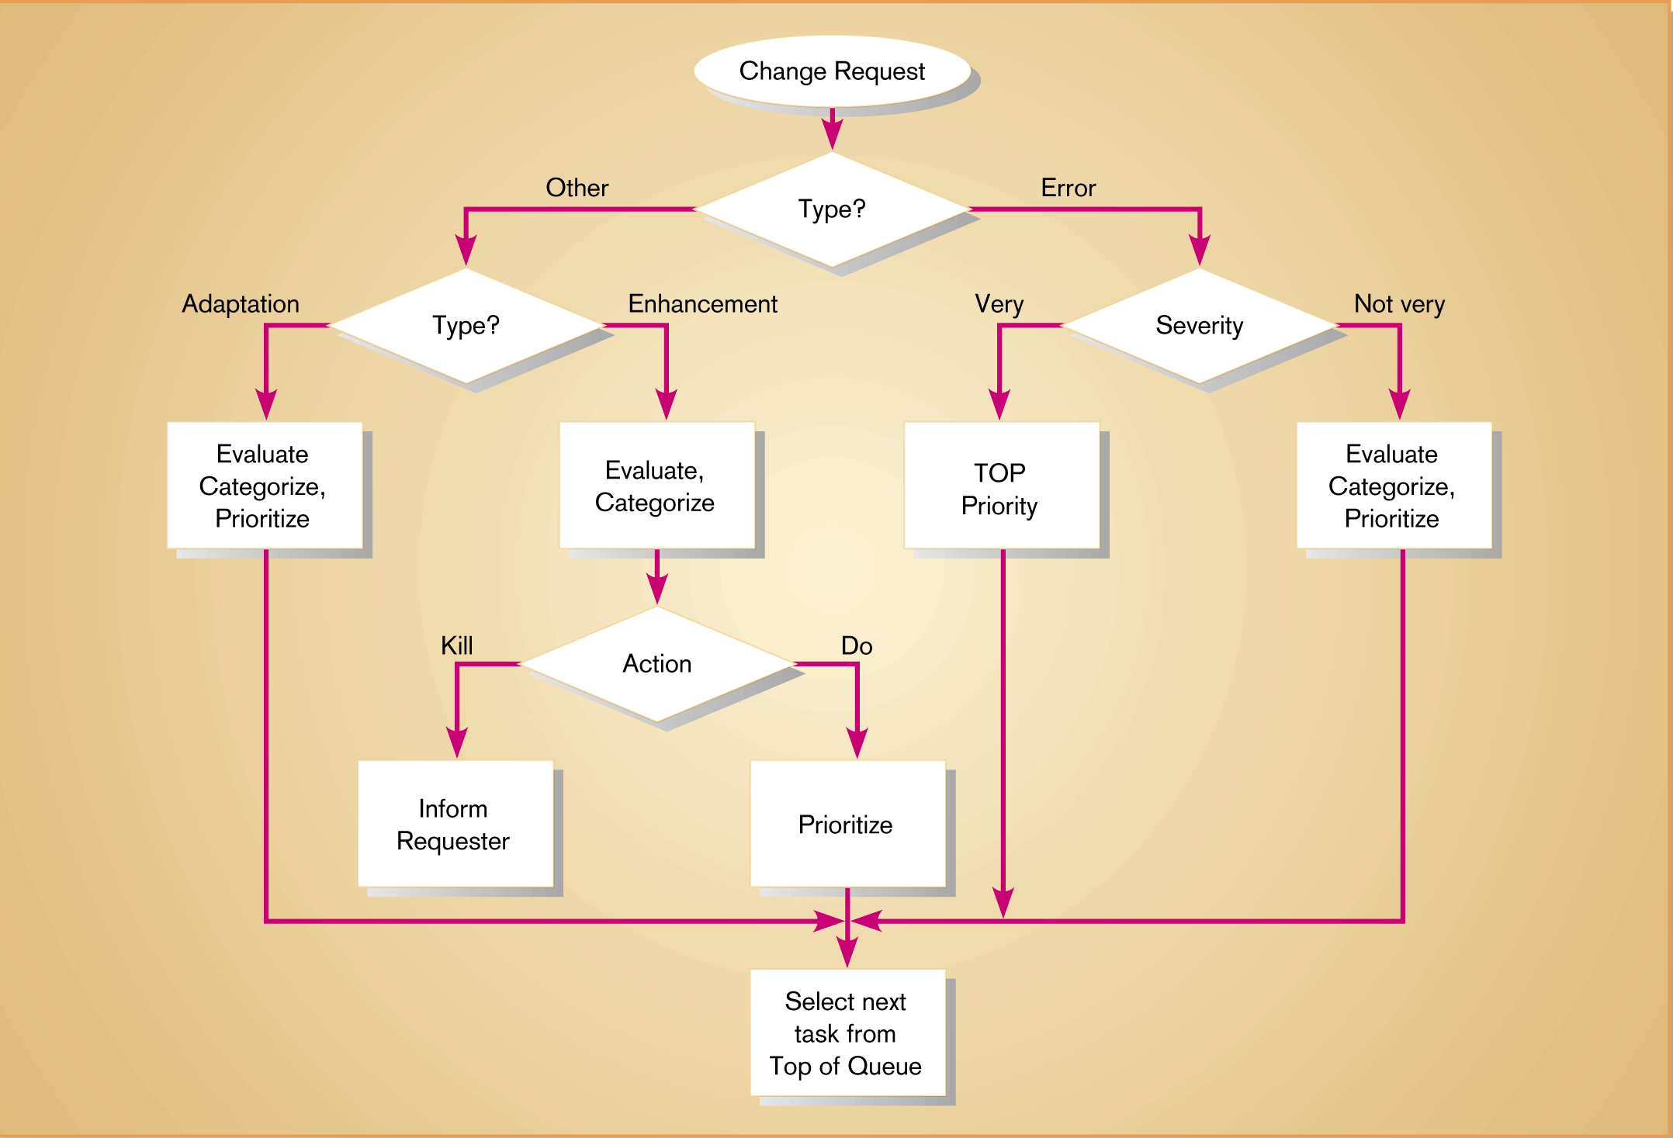
Figure 18-9
Flowchart of how to control maintenance requests (Adapted from Pressman, 1992)
18.<number>

Slide 12
Configuration Management
The process of assuring that only authorized changes are made to the system
Baseline modules
  Software modules that have been tested, documented, and approved to be included in the most recently created version of a system
System librarian
  A person responsible for controlling the checking out and checking in of baseline modules when a system is being developed or maintained
Build routines
  Guidelines that list the instructions to construct an executable system from the baseline source code
18.<number>

Slide 13
Role of CASE and Automated Development Tools in Maintenance
Traditional systems development
  Emphasis on coding and testing
  Changes are implemented by coding and testing first
  Documentation is done after maintenance is performed
  Keeping documentation current is often neglected due to time-consuming nature of task
Development with CASE
  Emphasis is on design documents
  Changes are implemented in design documents.
  Code is regenerated using code generators
  Documentation is updated during maintenance
18.<number>

Slide 14
Website Maintenance
Special considerations
  24 X 7 X 365
    Nature of continuous availability makes maintenance challenging
    Pages under maintenance can be locked
    Date and time stamps
  Check for broken links
  HTML Validation
    Pages should be processed by a code validation routine before publication
18.<number>

Slide 15
Website Maintenance
Special considerations (continued)
  Re-registration
    When content significantly changes, site may need to be re-registered with search engines
  Future Editions
    Consistency is important to users
    Post indications of future changes to the site
    Batch changes
18.<number>

Slide 16
Summary
Maintenance
  Corrective
  Adaptive
  Perfective
  Preventive
Cost of maintenance
Managing Maintenance
Measuring effectiveness of maintenance
18.<number>

Slide 17
Summary
Controlling maintenance requests
Configuration management
Role of CASE and Automated Development Tools in Maintenance
Website Maintenance
18.<number>

